Slide 1
Deliverable 2
Theodore Georgiou, Alexander Little, Arya Khosravi

Slide 2
Task Breakdown
Arya
File loader GUI
FFT/Visualizer/Analyzer gui + code
Distortion/Bitcrush code
Threadpool/Jobs coding
Theo
Reverb plugin GUI + code
Timeline pos/BPM GUI + code
Phaser GUI + code
Clips GUI + code
Alex
Equalizer code
Notes GUI + code
Audio recording code
File saving/exporting code
Ahmet
File loader code
Synth GUI + code
Stereo/multi-fx/chorus code
Drag and Drop code

Slide 3
Input and Output Data Grid
Input | Output
Audio file name | Audio File appears on track
Synthesizer parameters | Audio function with data points
Reverb parameters (knobs/sliders) | Audio with reverb effect
Instrument selection (buttons) | Ability to play notes of an instrument
Selected settings | Modified pitch
Play selected audio file | Visualized audio

Slide 4
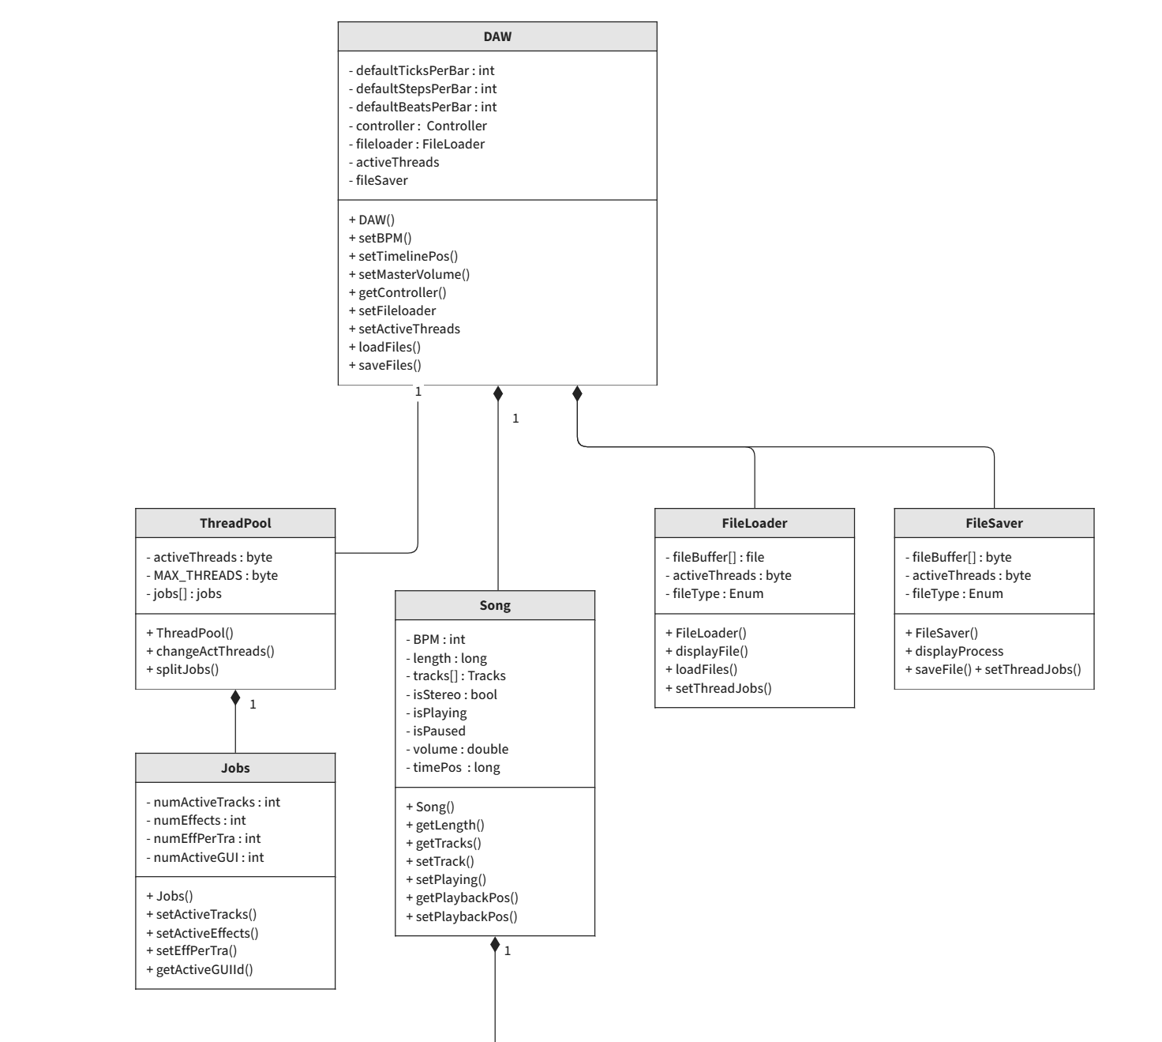
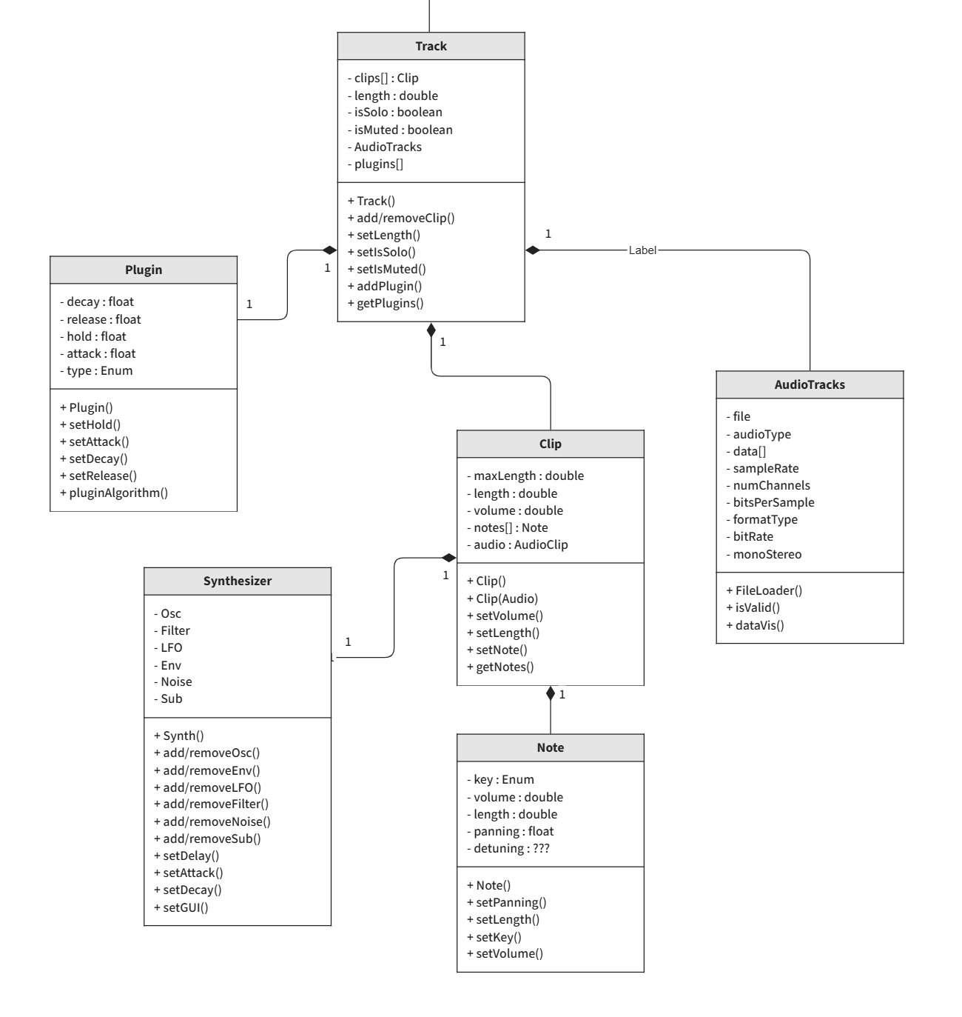
Class Diagram

Slide 5
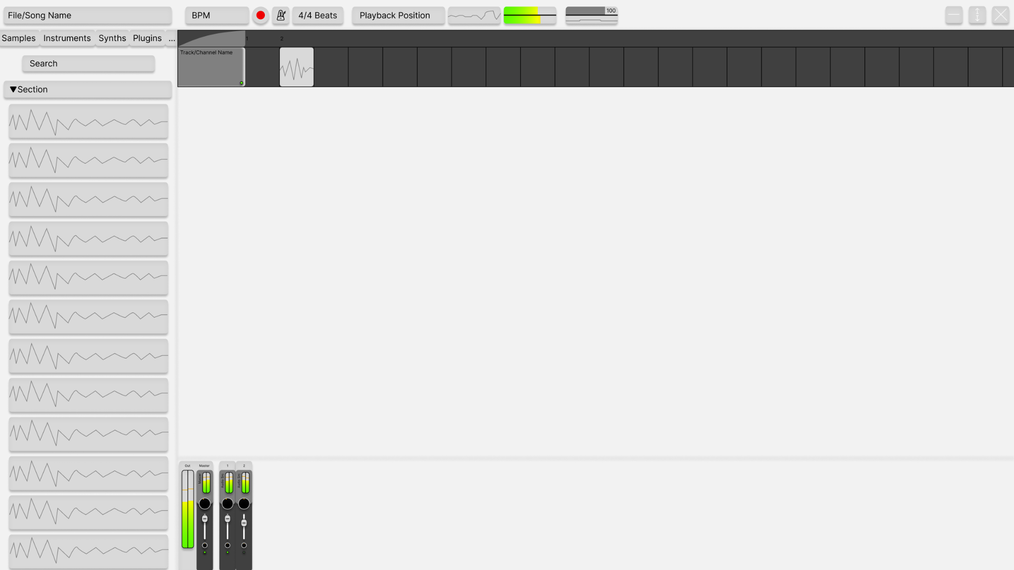
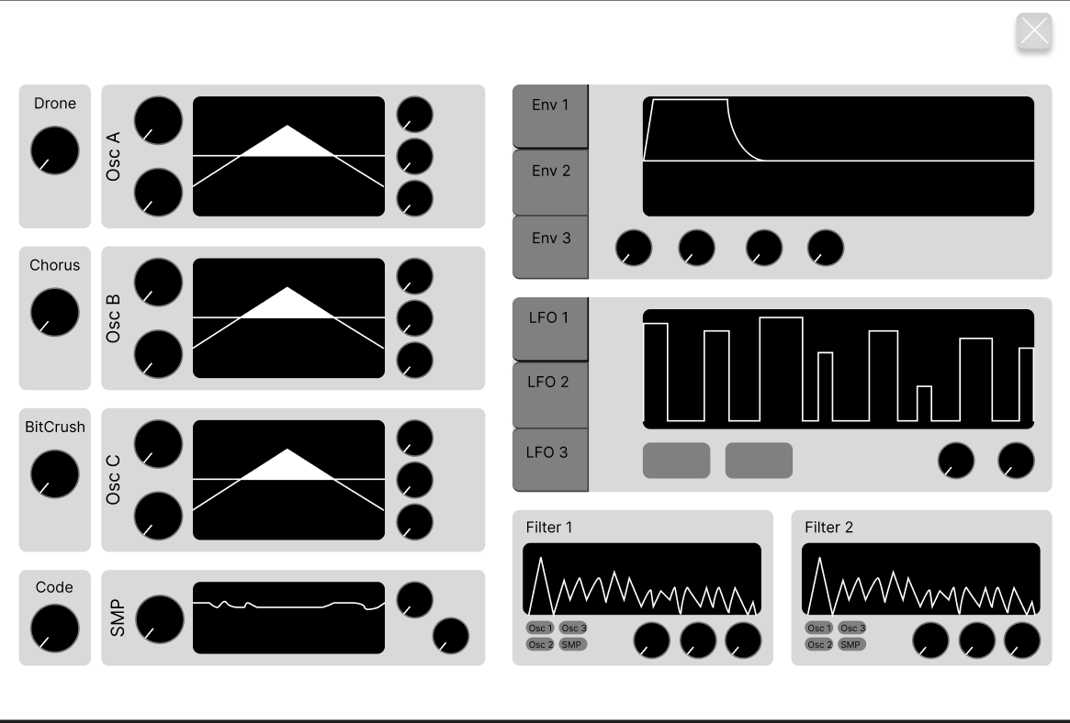
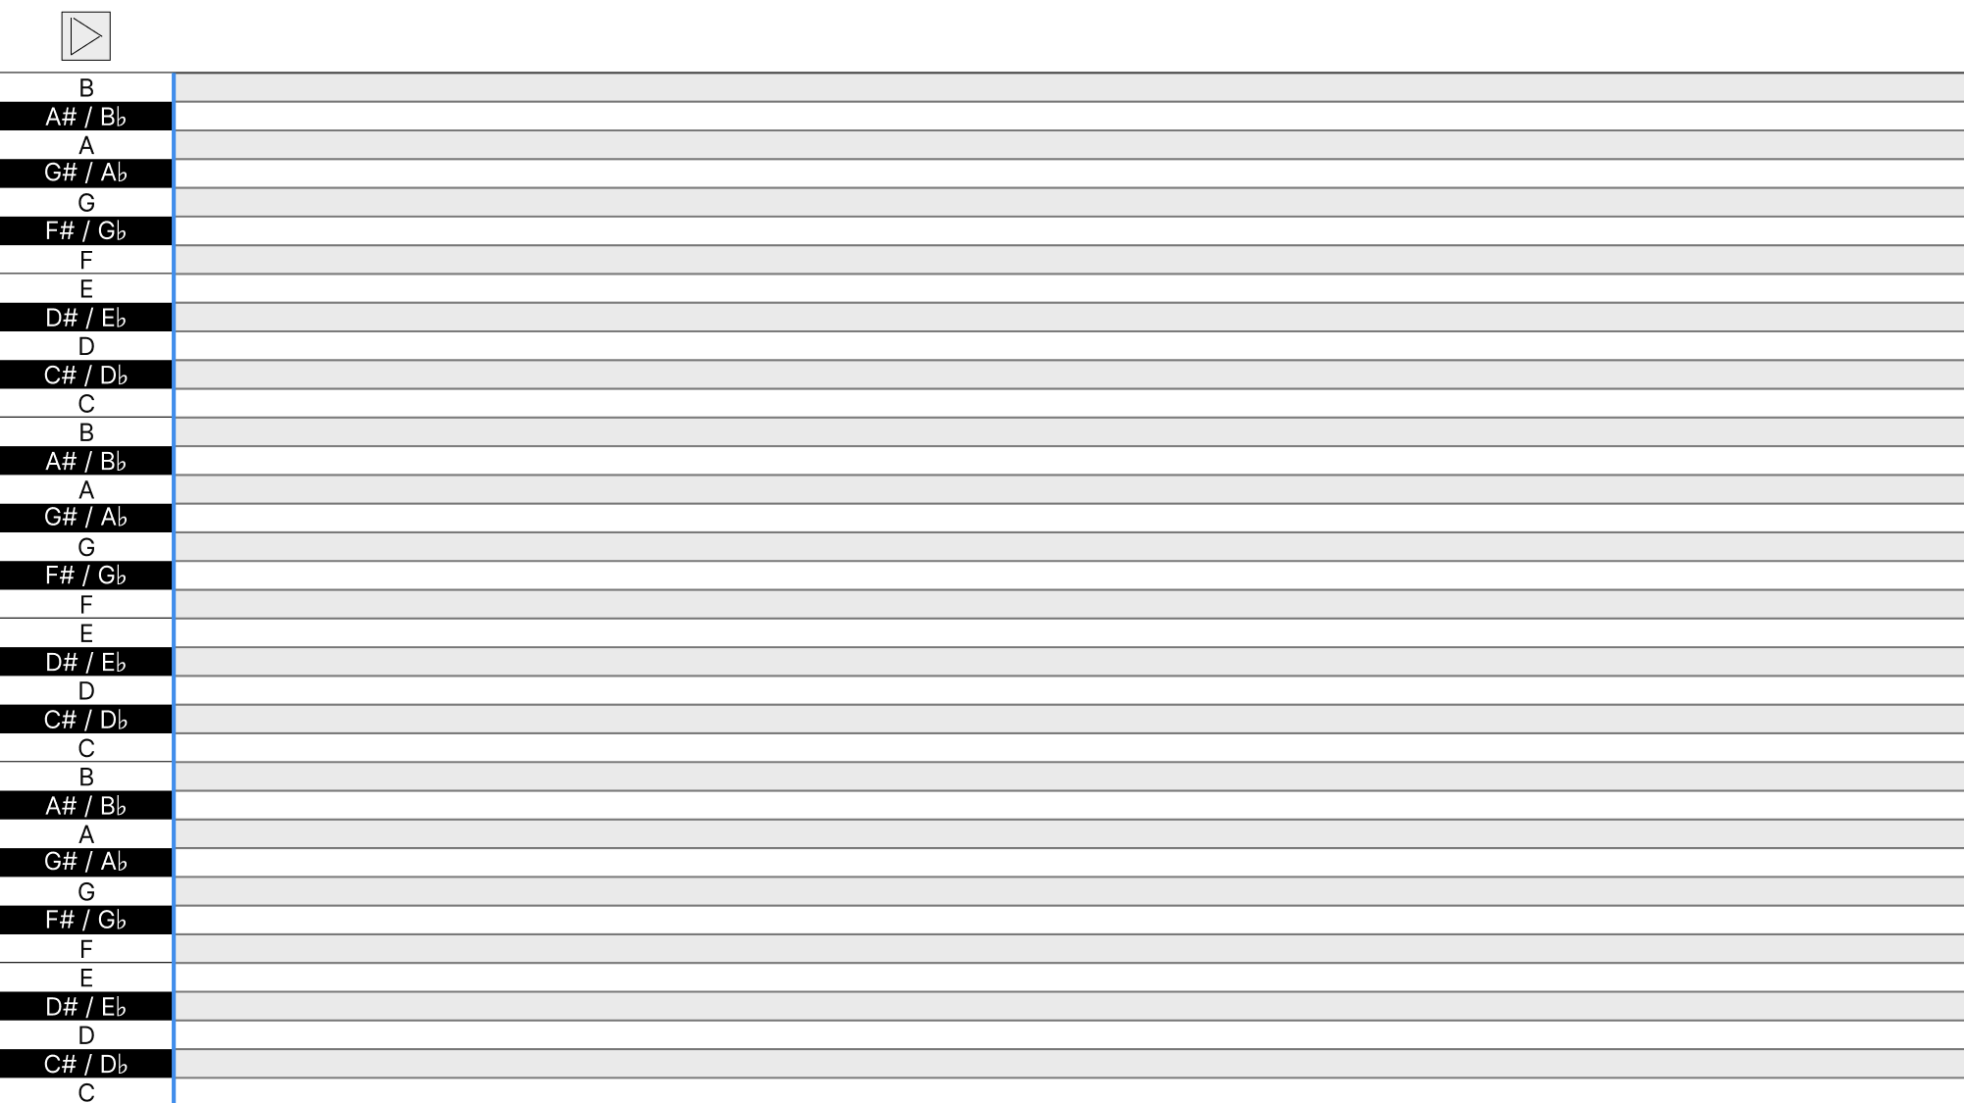
Wireframe

Slide 6
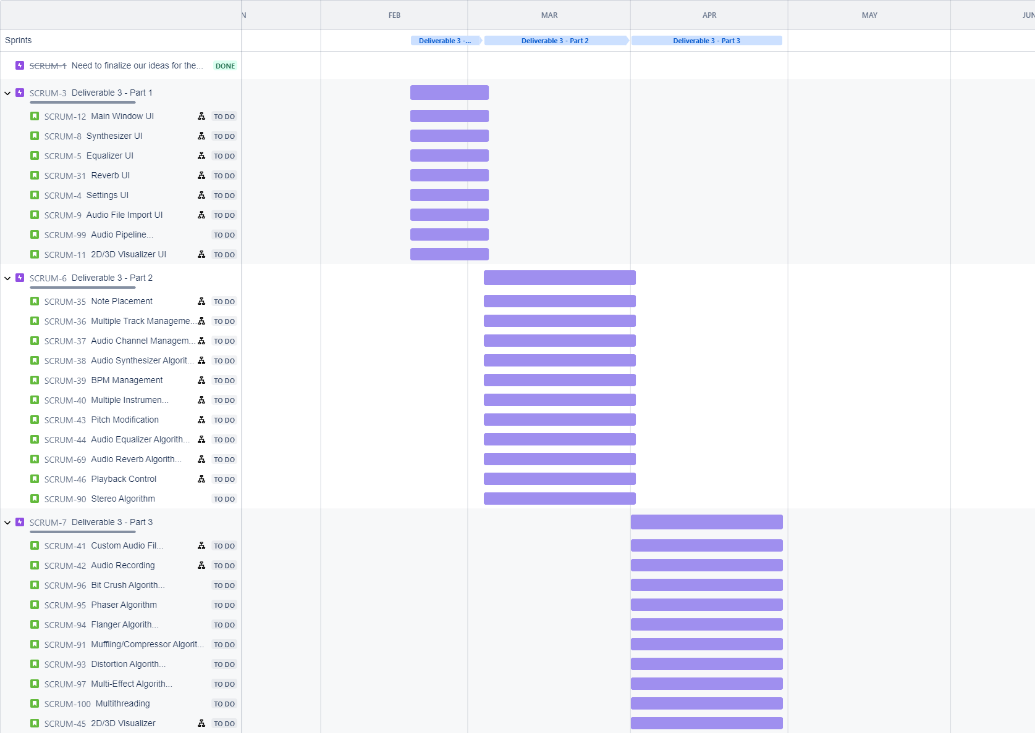
Jira Board

